Slide 1
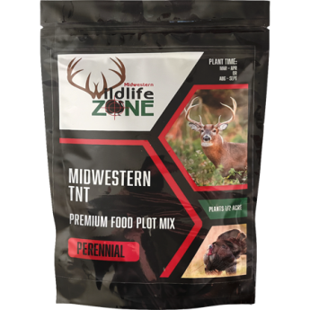
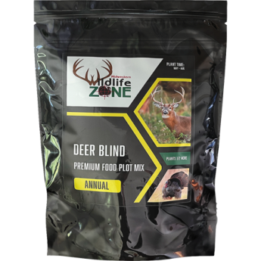
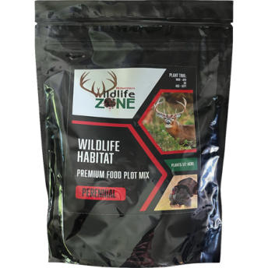
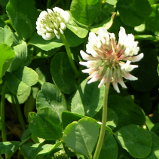
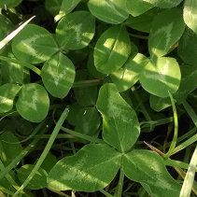
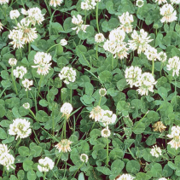
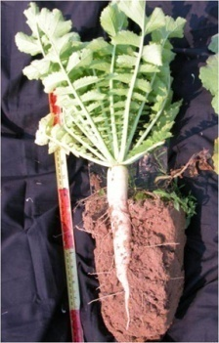
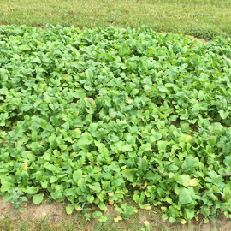
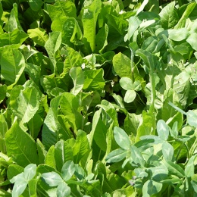
Deer Plot Seed
*All prices subject to change*
MWZ Tine-N-Turkey
MWZ Frozen Forage
MWZ Venison Veggies
Perennial grazing mix of alfalfa and clover.
Plant March/April or August/September
Annual mix of radish, turnip, rape seed and chicory.
Plant late July-mid September
Quick growing annual mix of Sunn hemp, Sugar beets, turnips, and peas.
Plant May-August
$ 25.75/5 lb
½ acre coverage
$ 17.25/4 lb
½ acre coverage
$ 17.25/5 lb
½ acre coverage
MWZ Deer Blind
MWZ Wildlife Habitat
Annual screen mix of Egyptian Wheat, sorghum, sudangrass, Sunn Hemp and sunflowers.
Plant late May-early August
Perennial mix to provide cover with Festulolium, ryegrass, clover, timothy, alfalfa, sunflower, and rape seed.
Plant March/April or August/September
$ 23.75/10 lb
¼- ½ acre coverage
$40.95/10 lb
1/3 acre coverage
Forage by the Pound
Ladino White Clover
Advantage Ladino Clover
White Dutch Clover
Great legume for pastures. Provides nitrogen and protein content to a pasture. Very large leaves.
Great for pastures or wildlife plots. Remains in vegetative state during whitetail deer antler growth.
Works well as a forage. Small leaves, low growing.
$6.10/pound
$5.77/pound
$6.71/pound
Groundhog Radish
Purple Top Turnip
Oasis Chicory
Radishes convert starches to sugars when cold temperatures occur, making them especially appealing during the late fall and winter.
High bulb yielding turnip that grows with the "globe” exposed providing easy access to the entire plant.
Oasis chicory is a high quality, high yielding, broad-leaved perennial forage herb.
$4.84 / 2 pounds
$7.80 / 2 pounds
$14.00 /2 pounds
Bulk Deer Feed
300 pound minimum. Packaged in bulk bags (60-70lb bags)
Please give 24 hour notice. Call for pricing. 614-873-4621

Slide 2
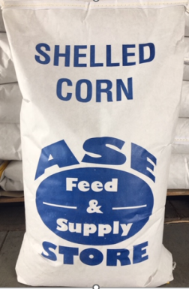
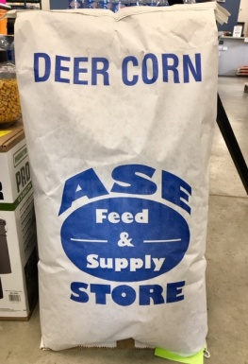
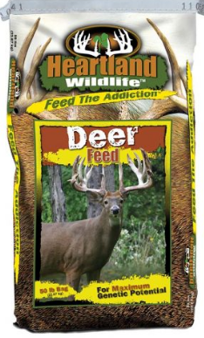
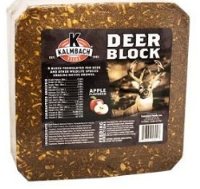
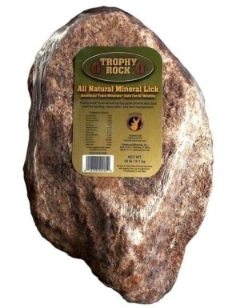
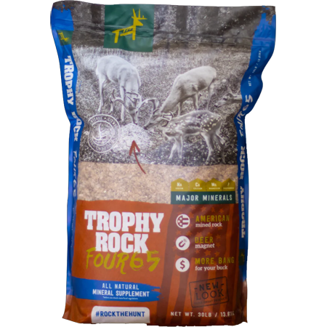
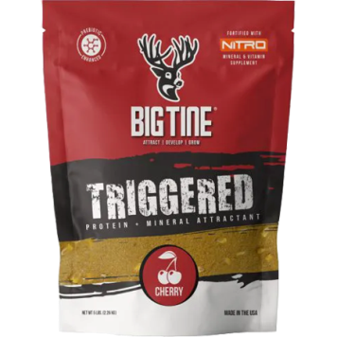
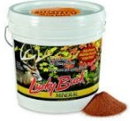
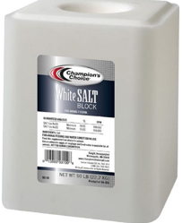
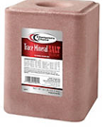
Deer Product Guide
Whole Shelled Corn
Apple Flavored Deer Corn
Whole kernel corn
Feed free choice
Whole kernel corn with apple Flavoring and soy oil.
Feed free choice
$11.00/50 lb
Bulk pricing available
$13.50/50 lb
Bulk pricing available
Autumn Harvest T99AH
Apple Deer Block
A blend of whole re-cleaned shelled corn, whole re-cleaned roasted soybeans and a light coating of molasses.
Loaded with corn for supplemental energy.
Apple flavored for maximum attraction.
$22.00/50 lb bag
$9.95/20 lb block
Trophy Rock
Trophy Rock Mineral
Trophy Rock is an all natural attractant that provides deer 60+ trace minerals needed for optimum health.
Natural and easy way to provide over 65 different macro and micro trace minerals to your deer herd in a granular form
$18.95/20 lb rock
$14.95/30 lb bag
Big Tine Triggered
Cherry flavored high protein attractant.
Lucky Buck Mineral
• Use Year-Round
• Develop bigger, better racks
• Minerals deer love
• Ingredient for portion control
$11.50/ 5 lb bag
$19.40/20 lb bucket
White Salt Block
Trace Mineral Block
Economical and efficient feed for introducing salt as a nutrient into an animal's diet. Weather-resistant for free-choice feeding.
Includes trace minerals that complement the diet to help promote digestion, growth, maintenance of body tissues, proper reproductive processes, and general animal well-being.
$9.30/50 lb block
$11.20 /50 lb block

